Slide 1
Automata Theory and formal languages
An Introduction

Slide 2
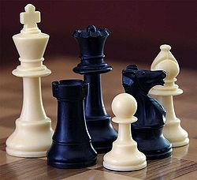
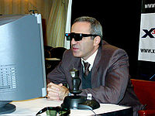
What are computers good at?
In 1997, IBM Deep Blue defeated world chess champion Gary Kasparov in a six match tournament.
3 ½
2 ½

Slide 3
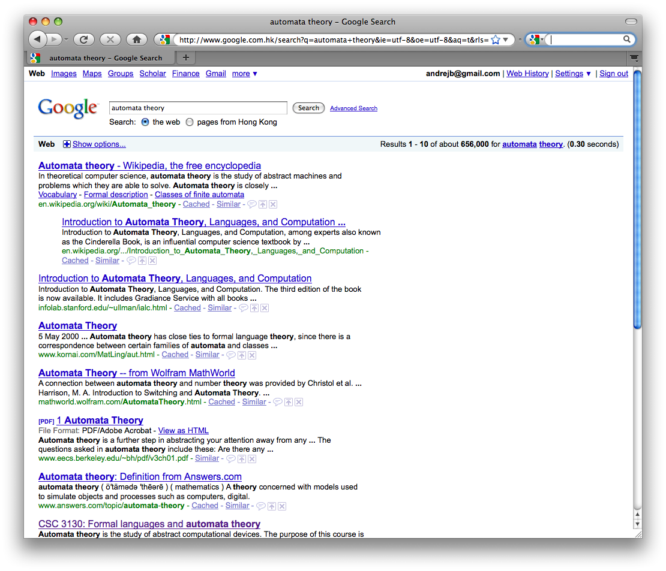
What are computers good at?
The search engine Google indexes 2,000,000,000 web pages. It lets you find pretty much anything you want

Slide 4
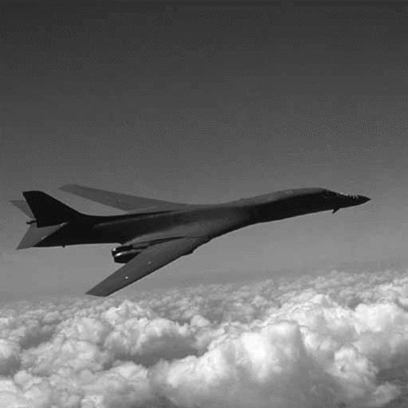
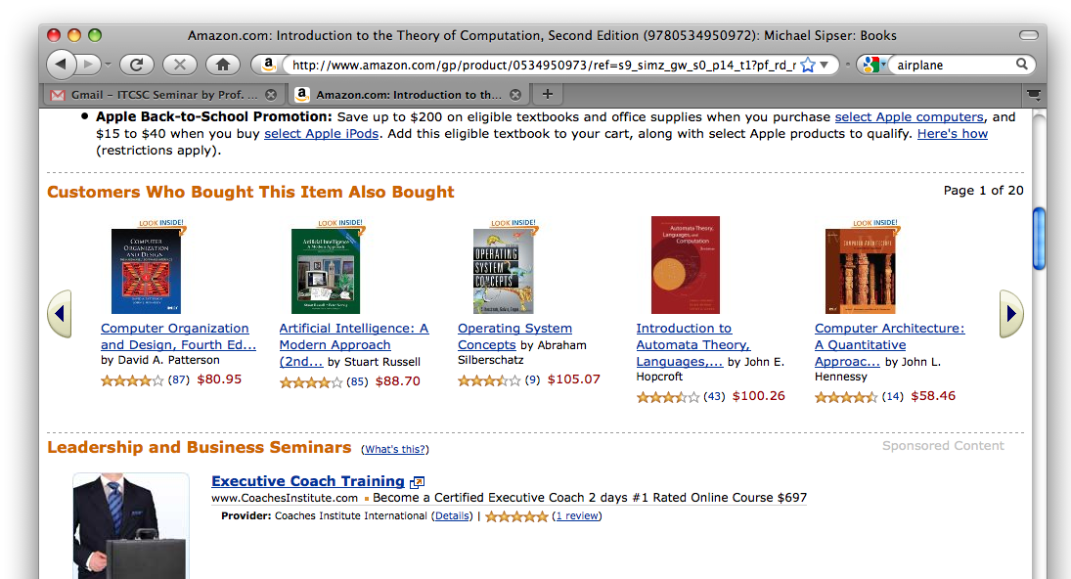
What else?
Recommend books
Fly airplanes
Is there anything a computer cannot do?

Slide 5
The laws of computation
Just like the laws of physics tell us what is (im)possible for nature to do… the laws of computation tell us what is (im)possible for computers

Slide 6
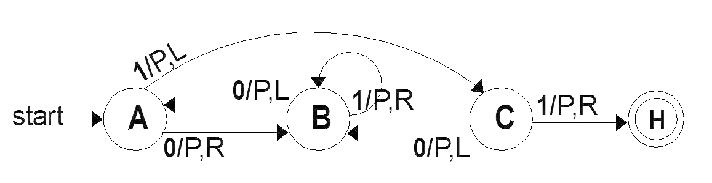
Automata theory
Automata theory studies the laws of computation
In reality, the laws of computation are not quite understood, but automata theory is a good start

Slide 7
A simple game
-2
-1
middle
1
2
A particle sits in the middle of the line
At each time, it moves 1 step left or 1 step right

Slide 8
A simple computer
even
odd
L, R
even
odd
L, R
Design an automaton that tells you if the particle is at an even or at an odd position

Slide 9
What is the difference?
Such devices are difficult to reason about, because they can be designed in an infinite number of ways
By representing them as automata, we will learn how to answer such questions
L, R
even
odd
L, R

Slide 10
Automata can model many things
They can describe the operation of a small device, like the control component of an alarm clock or a microwave
They are also used in lexical analyzers to recognize well formed expressions in programming languages:
ab1 is a legal name of a variable in java
5u= is not

Slide 11
Some devices we will see
Finite Automata | Devices with a finite amount of memory. Used to model “small” computers.
Push-down Automata | Devices with infinite memory that can be accessed in a restricted way. Used to parse grammars
Turing Machines | Devices with infinite memory. Used to model any computer.
Time-bounded Turing Machines | Infinite memory, but bounded running time. Used to model any computer program that runs in a reasonable amount of time.

Slide 12
Some highlights of the course
Finite automata
We will see that automata are intimately related to the task of searching for patterns in text
Grammars
Grammars describe the meaning of sentences in English, and the meaning of programs in Java
We will see how to extract the meaning out of a program
find (ab)in abracadabra

Slide 13
Some highlights of the course
Turing Machines
This is a general model of a computer, capturing anything we could ever hope to compute
But there are many things that computers cannot do

Slide 14
Some highlights of the course
Time-bounded Turing Machines
Many problems are possible to solve on a computer in principle, but take too much time in practice
Traveling salesman: Given a list of cities, find the shortest way to visit them and come back home
Hard in practice: For 100 cities, this would take 100+ years even on the fastest computer!
Beijing
Xian
Chengdu
Shanghai
Guangzhou
Hong Kong

Slide 15
Preliminaries of automata theory
How do we ask the question
First, we need a way of describing the problems that we are interested in solving
Can device A solve problem B?

Slide 16
Problems
Examples of problems we will consider
Given a word s, does it contain the subword “fool”?
Given a number n, is it divisible by 7?
Given a pair of words s and t, are they the same?
All of these have “yes/no” answers

Slide 17
Alphabets and strings
A common way to talk about words, numbers, pairs of words, etc. is by representing them as strings
To define strings, we start with an alphabet
An alphabet is a finite set of symbols
Σ₁ = {a, b, c, d, …, z}: the set of letters in English
Σ₂ = {0, 1, …, 9}: the set of (base 10) digits
Σ₃ = {a, b, …, z, #}: the set of letters plus the special symbol #

Slide 18
Strings
A string over alphabet Σ is a finite sequence of symbols in Σ
abfbz is a string over Σ₁ = {a, b, c, d, …, z}
9021 is a string over Σ₂ = {0, 1, …, 9}
ab#bc is a string over Σ₃ = {a, b, …, z, #}
The empty string will be denoted by ε
We write Σ* for the set of all strings over Σ

Slide 19
Languages
A language is a set of strings (over the same alphabet)
Languages describe problems with “yes/no” answers
L₁ = All strings that contain the substring “fool”
Σ₁ = {a, b, …, z}
foolish, fools, fool are in L₁
ε, oyster are not in L₁
L₁ = {x ∈ Σ₁*: x contains the substring “fool”}

Slide 20
Examples of languages
L₂= {x ∈ Σ₂* : x is divisible by 7}
Σ₂ = {0, 1, …, 9}
L₂ = {7, 14, 21, …}
L₃ = {s#s : s ∈ {a, b, …, z}*}
Σ₃ = {a, b, …, z, #}
ab#ab
in L₃
ab#ba
not in L₃
a##a#
not in L₃

Slide 21
Definitions
Symbol – An atomic unit, such as a digit, character, lower-case letter, etc. Sometimes a word.
Formal language does not deal with the “meaning” of the symbols
Alphabet – A finite set of symbols, usually denoted by Σ.
Σ = {0, 1} Σ = {0, a, , 4} Σ = {a, b, c, d}
String – A finite length sequence of symbols, presumably from some alphabet.
u=ε w = 0110 y = 0aa x = aabcaa z = 111
special string: ε (also denoted by λ)
concatenation: wz = 0110111
length: |w| = 4 |x| = 6 but |u| = 0
reversal: y^{R} = aa0

Slide 22
Definitions
Some special sets of strings:
Σ* All strings of symbols from Σ
Σ⁺ Σ* - {ε}
Example:
Σ = {0, 1}
Σ* = {ε, 0, 1, 00, 01, 10, 11, 000, 001,…}
Σ⁺ = {0, 1, 00, 01, 10, 11, 000, 001,…}
A (formal) language is:
1) A set of strings from some alphabet (finite or infinite), in other words…
2) any subset L of Σ*
Some special languages:
{} The empty set/language, containing no strings
{ε} A language containing one string, the empty string.

Slide 23
Definitions
Σ = {0, 1}
L = {x | x is in Σ* and x contains an even number of 0’s}
Σ = {0, 1, 2,…, 9, .}
L = {x | x is in Σ* and x forms a finite length real number}
L = {0, 1.5, 9.326,…}
Σ = {a, b, c,…, z, A, B,…, Z}
L = {x | x is in Σ* and x is a Pascal reserved word}
L = {BEGIN, END, IF,…}
Σ = {English words}
L = {x | x Σ* and x is a syntactically correct English sentence}

Slide 24
Fundamental Concepts
Language (L)
Set of all strings constructed from an alphabet
Concatenation
Reverse
Length
Empty string (ε or λ)
Substring
Prefix or suffix
Finite language
Star Closure (*)
Grammar
Automata

Slide 25
Grammar
It is defined as G=(V, T, S, P)
V is the finite set of objects called the variables
T is a finite set of objects called the terminal symbols
S belongs to V and is called as the start variable
P is a finite set of production

Slide 26
Finite Automata
Input
Control
Storage
Output

